Slide 1
HARRODS ONLINE
Forecast.
Event
Planning
Financial
Planning
HR
Credit
Auth
Merch
Planning
Payroll
Planning
Allocation
Pricing
Item
Maint
Content
Mgmt
Item
Maint
PO
Mgmt
Replen.
Aggregated
Sales
Sales
Rptg
Order
Mgmt
Catalogs
A/P
GL
CRM
Commerce
Site
Shipping
Customer
Srvc
Stock
Ledger
Inventory
Mgmt
Order
Mgmt
SUPPLIER
Exports
CONSUMER
Invoice
Match
Order
Place
Call
Center
Inventory
Mgmt
Order
Mgmt
Merch.
Imports
Whse
Mgmt
Picking
Shipping
Returns
RTV’s
Transfers
SPIEGEL

Slide 2
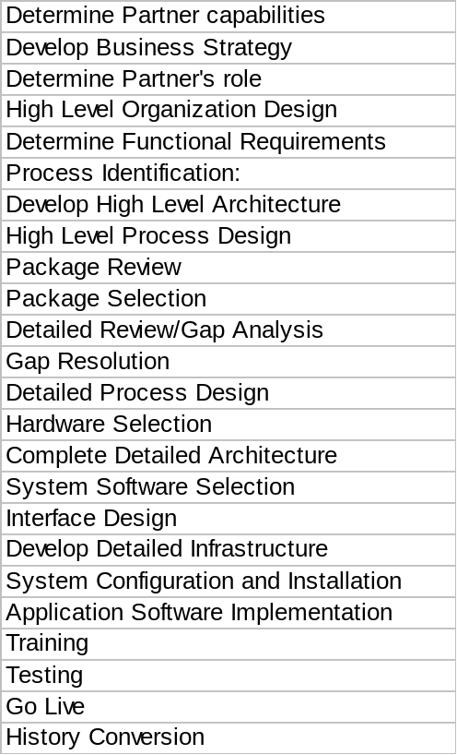
Business Management Systems
September October November December January February March

Slide 3
Retail Footprint
Planning, Replenishment & Merchandise Management
Warehouse Management
Merchandise
Store
Plan-o-gram/
Store Allocations >
Landing and
Merchandise
Warehouse
/Assortment
Planning
Space
Vendors >
Receiving
Processing
Management
Planning
Planning
Stores >
SKU's >
Open-to-Buy
Purchase
Import
Purchase Orders >
Control
Order
Management
< Receipts/Adjustments
DC to Store
Transport.
EDI
Management
< ASN's
Routing
Management
< Warehouse Shipments/Transfers
EDI
Replenish-
Invoices
Forecasting
Allocation
Hierarchies >
Rec's/Adj's >
ment
RTV's >
Stores >
WH Ship's >
Inventory Control
SKU's >
Merchandise
Vendor
Reference
< Sales
Stock Status/
Analysis and
Analysis
Systems
< Inventory
Perpetual
Stock
Sales Audit/
Reporting
L/C's >
Inventory
Ledger
Flash Sales
Invoices/Receipts >
Promo Events >
Decision Support
Price
Transfer
Physical
< Sales
Change
Control
Inventory
< Inventory
Control
Customer Marketing
Data Warehouse:
Return To
Item
- Merchandising
Vendor
Taxability
Promotional
Ad. and
Competitive
- Real Estate
Control
Planning
Promotion
Analysis
- Finance
Tracking
- Demographic and Competitive
Sales/
Analysis
Returns >
Inventory
Balances >
< Store Orders
General Accounting
Hierarchies >
Store Management
Signage Info >
Coop/
General
SKU's >
Point of
Check
Accounts
Rebate
Ledger and
Stores >
Sale
Authorization
Back Office
Payable
Control
Budgeting
POG >
Time &
Labor
Attendance
Expense
Fixed
Polling
Scheduling &
Time &
Human Resources
Purchasing
Assets
Performance
Attendance
Accounting
Store
Payroll
Human
Lease
RF
Signage &
Resources
Payroll
Cash
Management/
Loss
Applications
Ticketing
Management
Real Estate
Prevention
Benefits
Risk
Management
Legend:
Transaction Systems
Sales/Returns >
Enterprise Data
PC Counts >
Data Flow
RTV's >
< Transfers >
< Prices/PLU
1)Functionality of Market Max application not yet evaluated by PwC

